Slide 1

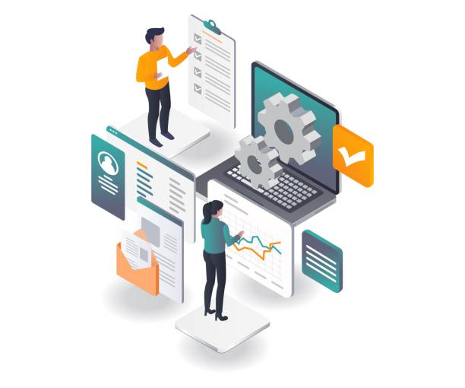
ERP Implementation for Planet Infra

Slide 2
Our Understanding of the requirement
Our modules
Procurement, Stores & Logistics
Sales
Services
HRMS
Accounting
DMS
Tender/Bid Process Management
Q&A
Content
YOUR TITLE
YOUR TITLE
YOUR TITLE

Slide 3

Our Understanding of the requirements

Slide 4
High Level Context
System Integration
Network Infrastructure
ERP provides a centralized repository for their data, allowing for efficient data sharing and integration between systems
ERP systems also provide visibility into the entire network infrastructure, making it easier to identify areas of inefficiency and solve it faster
IT Consulting
Power Solution
ERP provides visibility into all aspects of a project, from resource allocation to project timelines to billing
ERP systems can track resources like energy consumption, labor, and materialsmaking it easier to track performance of systems installed

Slide 5

Our Modules

Slide 6
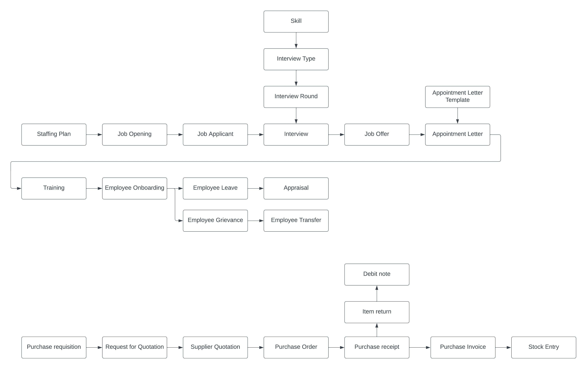
Procurement, Stores & Logistics

Slide 7
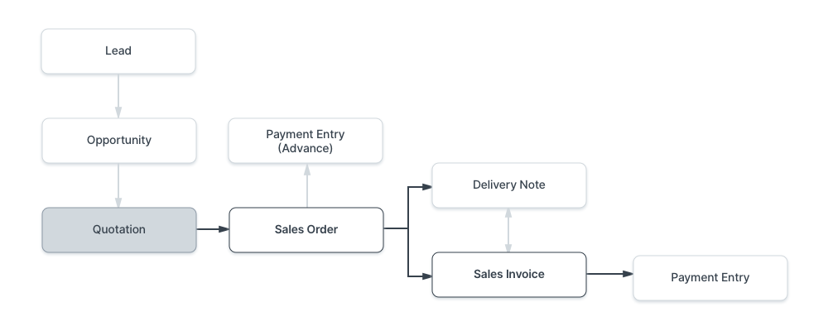
Sales

Slide 8
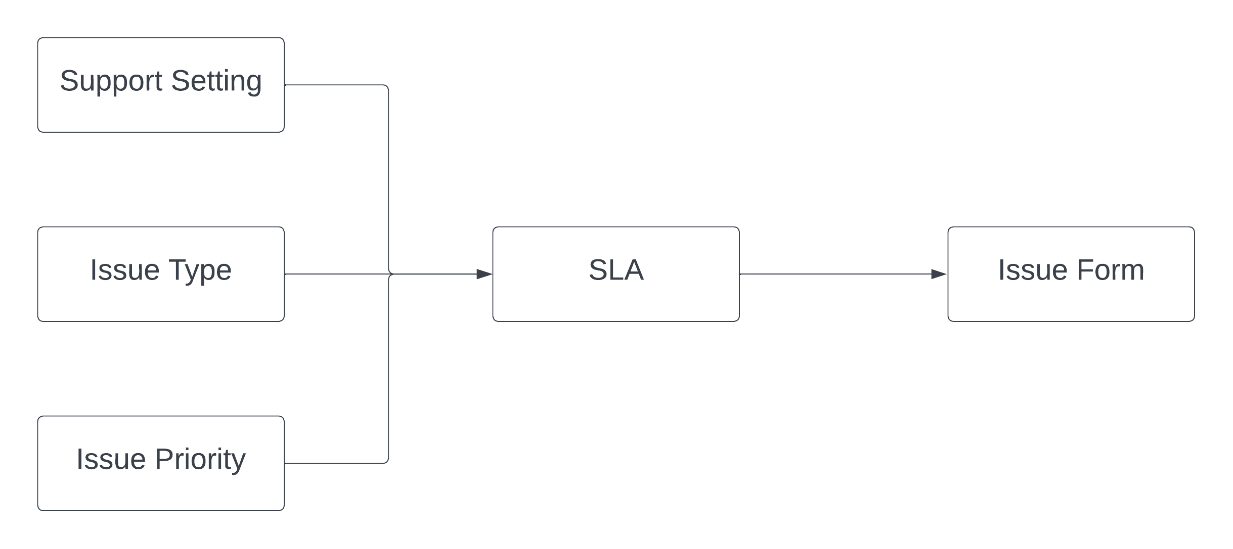
Service

Slide 9
HRMS

Slide 10
Accounting
1. Master
Company
Mode of Payment
Currency
Currency Exchange
Bank
Bank Account
Payment Gateway Account
Fiscal Year
2. Journal Entry
3. Chart of Account
4. Genral Ledger
5. Trial Balance
6. Trail Balance for Party
7. Profit and Loss Statement
8. Balance Sheet
9. Cash Flow
10. Consolidated Financial Statement

Slide 11
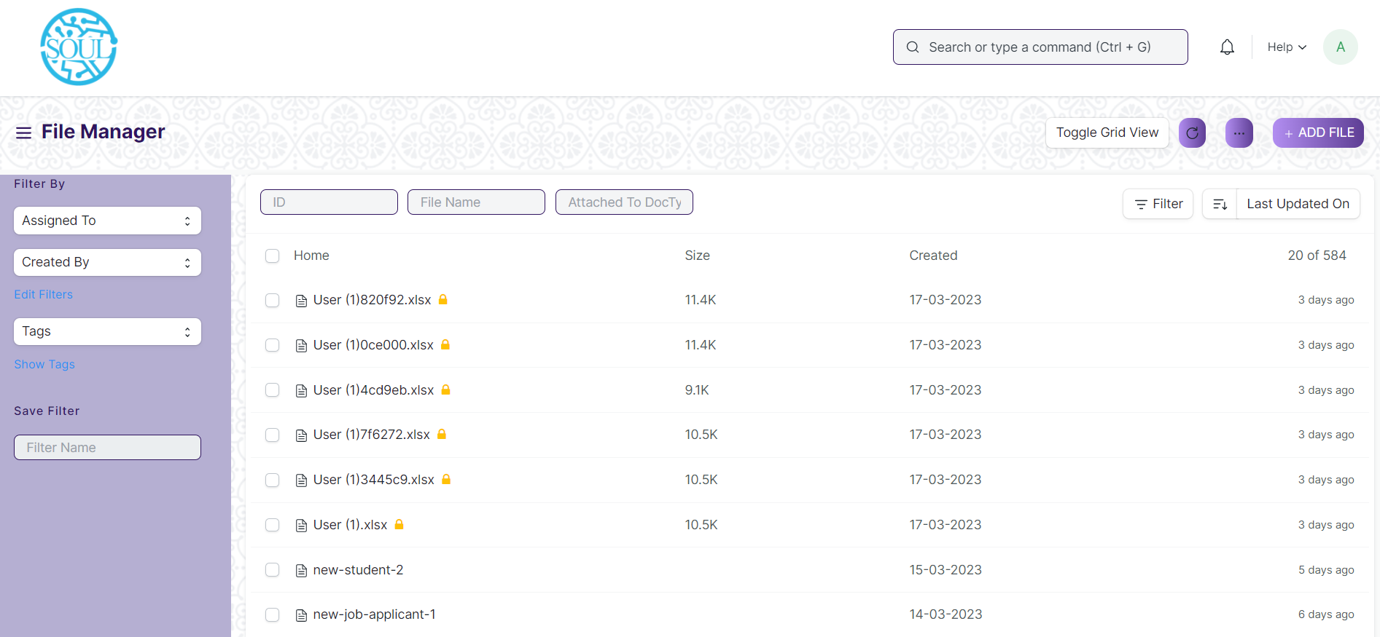
DMS

Slide 12
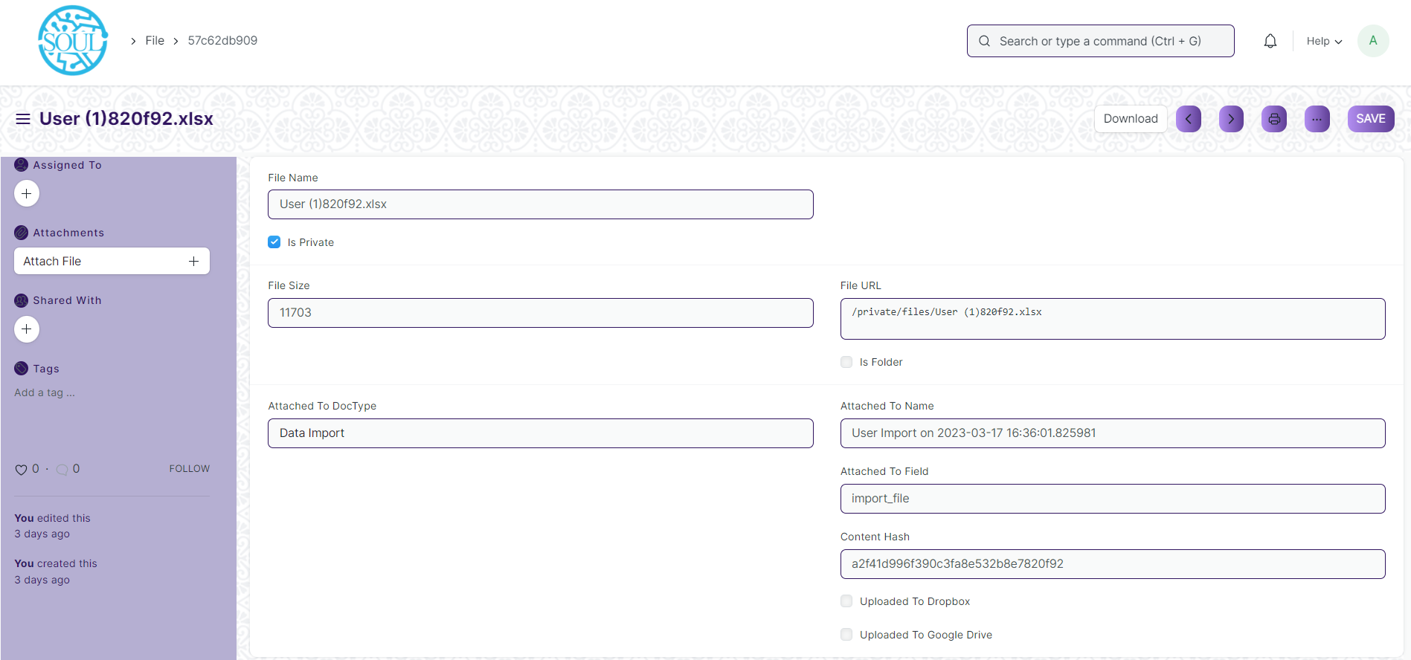
DMS

Slide 13
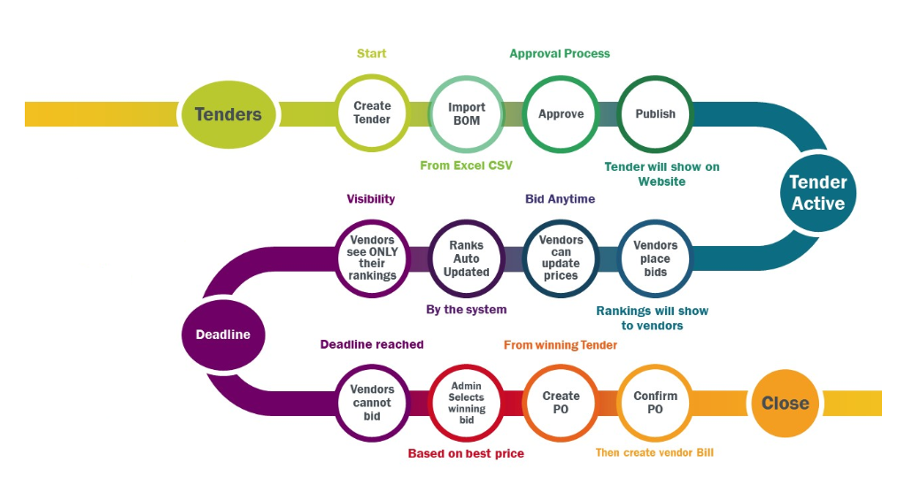
Tender/Bid Process Management

Slide 14

Questions

Slide 15

Thanks！

